Slide 1












AMPIFY
IPC Project - Energy Monitoring Application

Slide 2




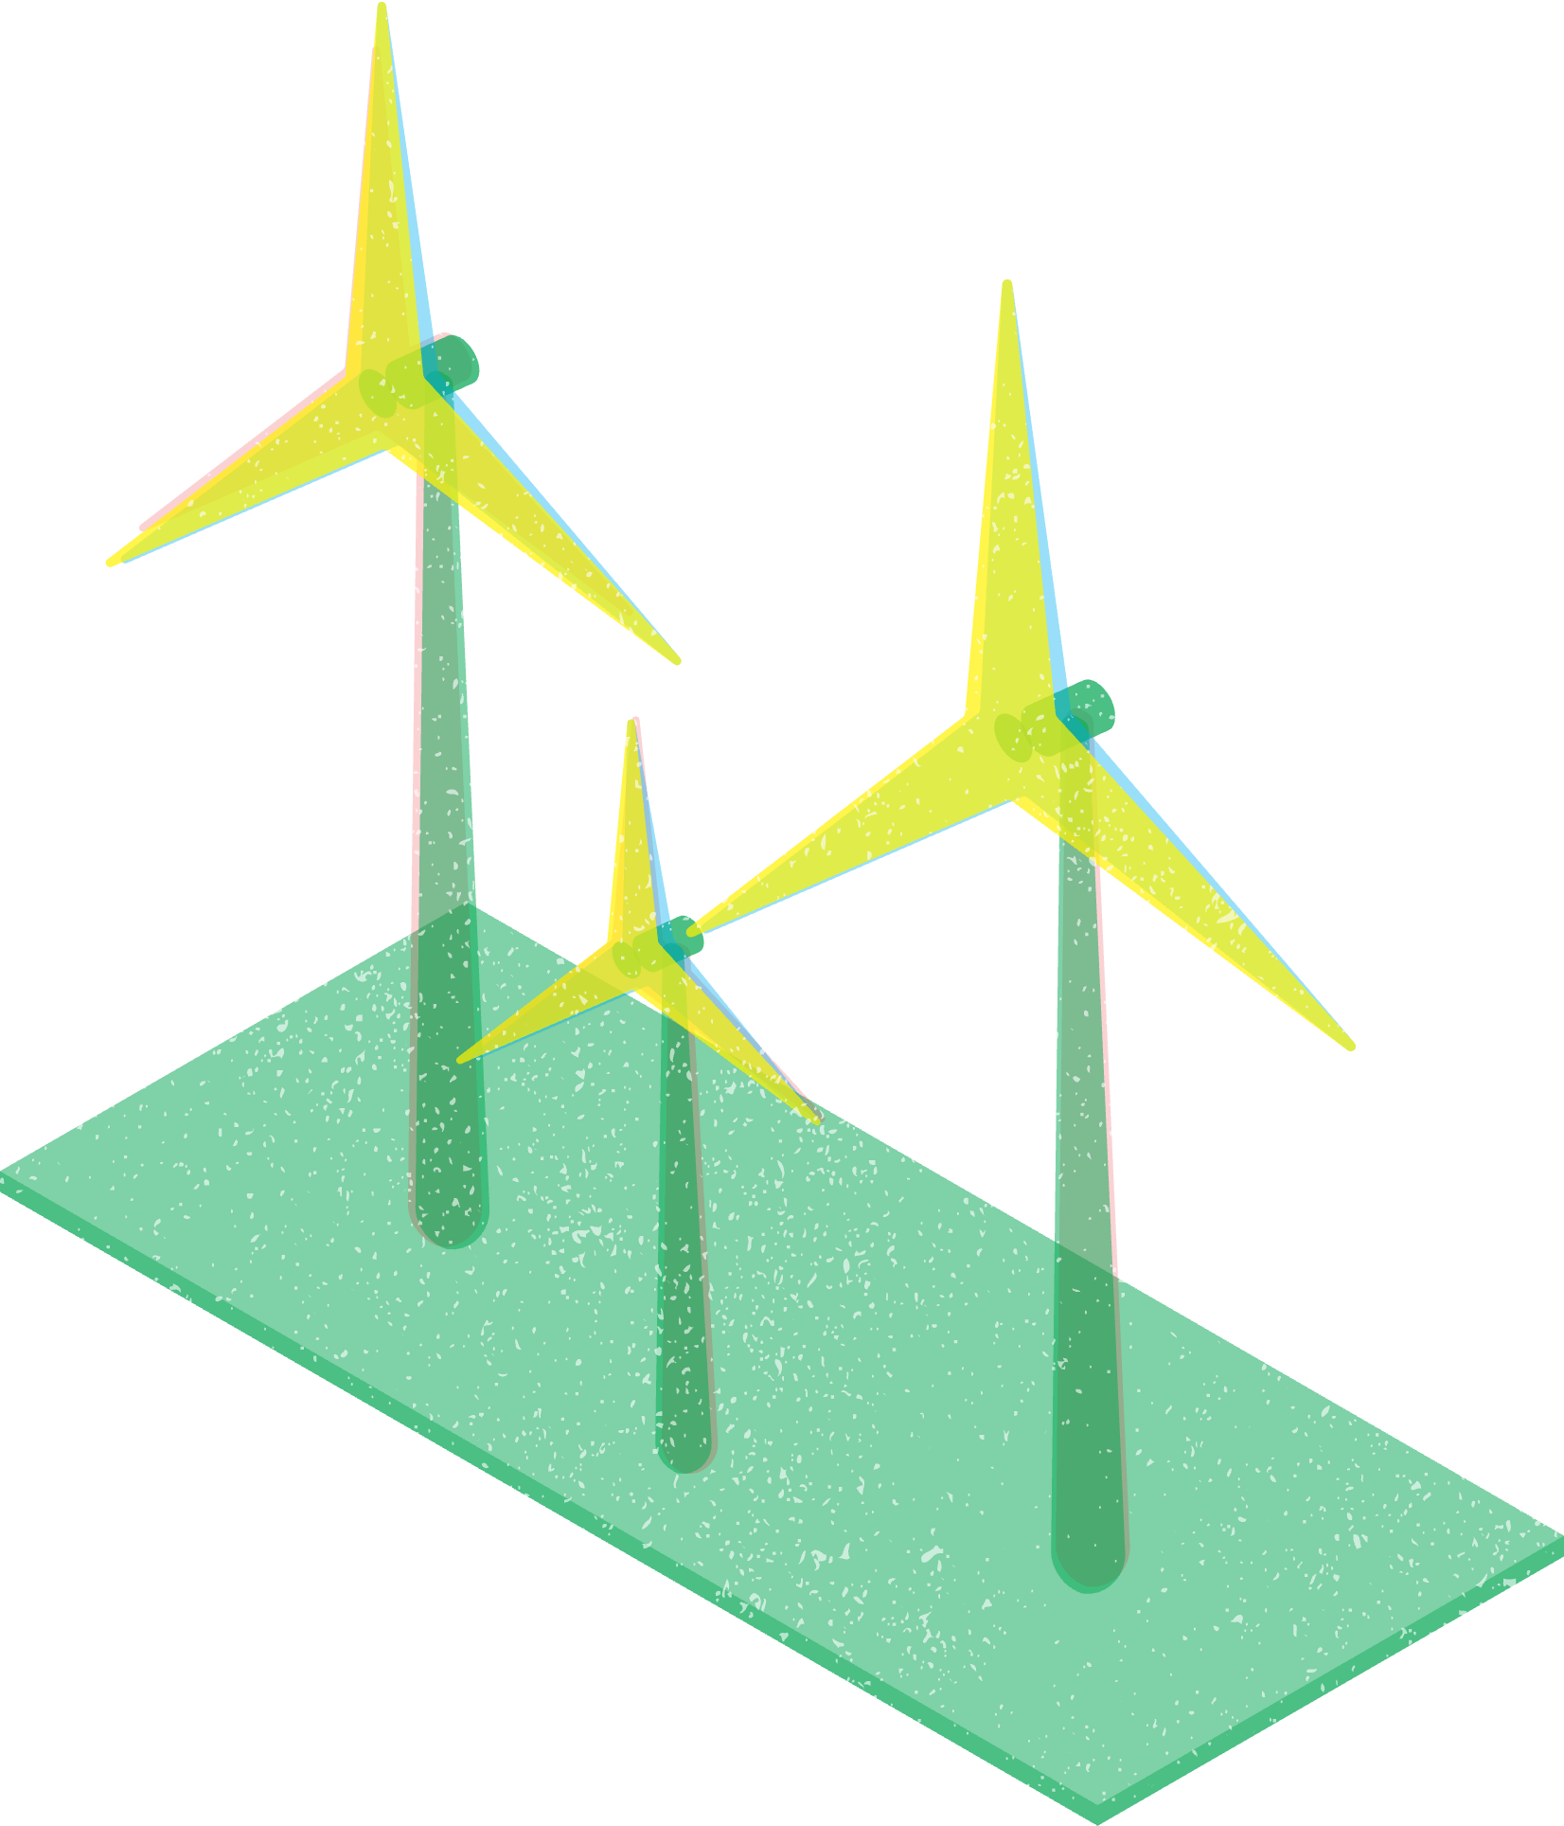




Project's Idea Description
The project aims to create a mobile app that helps users monitor their energy consumption in real time, receive alerts, and get recommendations to save energy and reduce costs.

Slide 3





Related Apps/Systems
Email:
-> Gmail
-> Outlook
-> etc
Social Network :
-> Instagram
-> Facebook
-> etc

Slide 4


Questionnaire highlights
The main target of this forms where diferent types of people and it was publish through Whatsapp Messages;
Total of responses was about 170 answers;
The majority of the participants were aged between 45 and 54 years old, with 92.8% of them being homeowners;
The percentage of people who find the idea of monitoring energy consumption through an app interesting is 70.7%
It should be highlighted that:
50.6% of participants monitor their energy consumption monthly, while 40% rarely or never monitor it. This indicates that many users could benefit from more frequent monitoring tools.
The main motivations for monitoring energy usage are paying bills (20.7%) and saving money (13.8%). However, some participants (9.7%) also monitor their consumption out of curiosity.
Regarding mobile app development, 47.6% of participants prefer innovation with frequent updates, while 34.7% prioritize stability in their applications. This suggests a need for balance between new features and maintaining familiarity with app functionality.

Slide 5

PACT Analysis
People: Diverse age groups, homeowners and tenants;
Activities: Monitoring energy usage, comparing bills, reducing costs;
Contexts: Households with different sizes
Technologies: Mobile apps, smart meters, potential future sensors

Slide 6


Persona Example
João Pedro
João has always been a very organized person, with a passion for the efficient use of resources. At 28 years old, with a degree in engineering, he works at a technology company and lives with his family. He is highly interested in optimizing energy consumption at home, leveraging new technologies to reduce environmental impact and save on electricity bills.
Motivated to reduce energy waste, João regularly uses an app that allows him to monitor energy consumption in real-time. He values innovation and is always looking for updates and features that help him manage energy usage more efficiently. His main monitoring tools are a smart meter and an energy management app.
Objectives/Needs:
Reduce energy consumption to minimize monthly costs.
Receive personalized suggestions on how to improve the home's energy efficiency.
Monitor energy consumption by device to identify which ones consume the most.
Get real-time notifications about abnormal consumption or energy spikes.
Frustrations:
Lack of smooth integration between the different smart devices he uses.
Feeling that some features of energy management apps are not user-friendly.
Challenges in keeping up with constant technological updates and learning how to use them efficiently.
Age: 28 years old
Profession: Engineer
Residence: Lives with 4 people
Hobbies: Running, palying football and Reading about new energy technologies
Pragmatic
Focused
Efficient
Dedicated

Slide 7

Activity scenario
João Pedro
João uses an energy management app to monitor the consumption of each device in his home. After noticing his energy bills steadily increasing, he decided to dive deeper into how each device was contributing to overall consumption. Through the app, João receives detailed monthly reports that break down the energy usage by device. One month, the app notified him that his air conditioner was consuming more energy than usual.
Following the app’s recommendations, João adjusted the settings to switch the air conditioner to an energy-saving mode during the day. He also programmed other high-consumption devices like his washing machine and dishwasher to run during off-peak hours.
The app also provided him with tips on improving efficiency in the kitchen, like keeping his refrigerator at the optimal temperature and making sure he wasn’t overloading it.
By using the app consistently, João identified the biggest energy drains in his home and applied suggestions to reduce consumption, leading to a significant decrease in his electricity bills. Additionally, João set up real-time alerts, so the app notifies him immediately if any device suddenly starts consuming more energy than expected. This helps him take immediate action to prevent further spikes in consumption.
Now, João feels more in control of his energy usage, enjoying both lower bills and the satisfaction of reducing his environmental impact.

Slide 8


Functionalities
Real-time energy monitoring
Monthly energy reports
Alerts for high energy usage
Personalized energy-saving tips
Sustainability mode with eco-friendly suggestions

Slide 9







Let's commit to clean energy for a sustainable future!
Thank you

